Slide 1
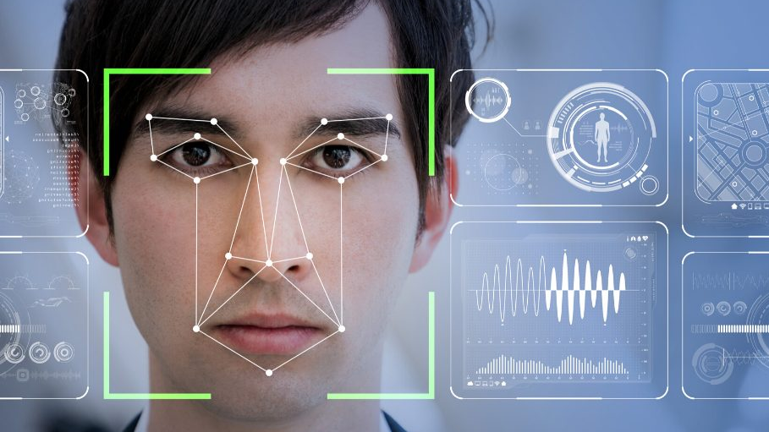
USE Case: Drunken Face recognition
Advanced machine learning

Slide 2
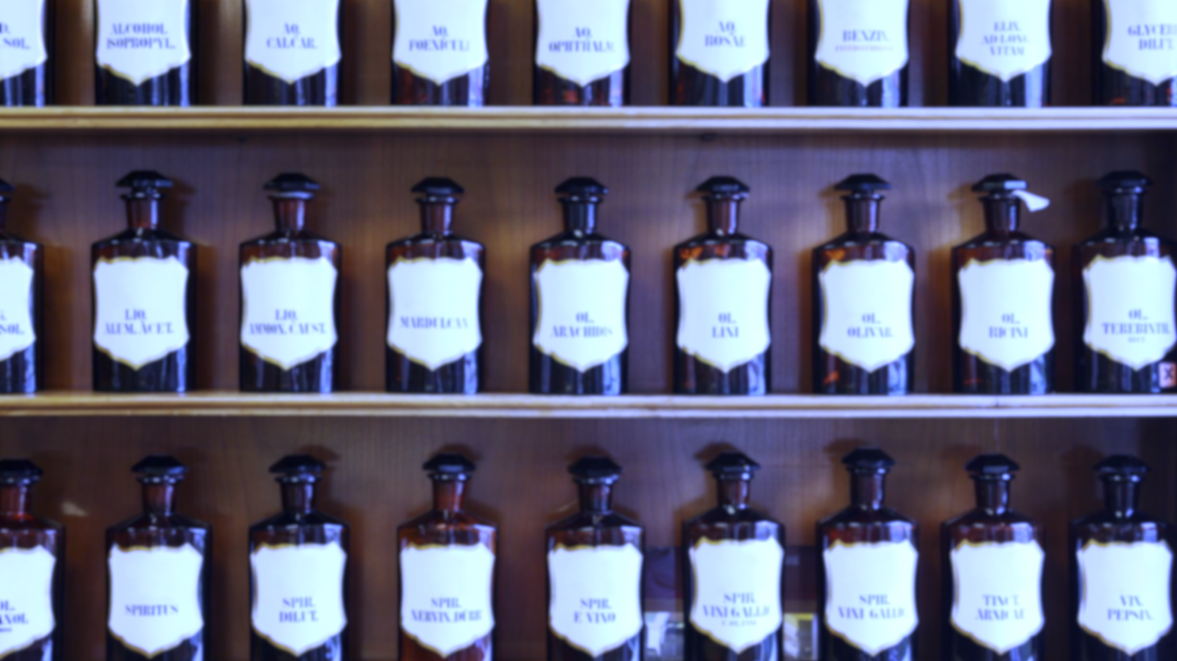
Goal:
The detection of the intoxicated state of a person Based on Facial Features
Either:
Scale from 0 – X Promille
Strongly Intoxicated Yes/No

Slide 3

APP
User takes Photo
App gives Information about the intoxicated state

Slide 4
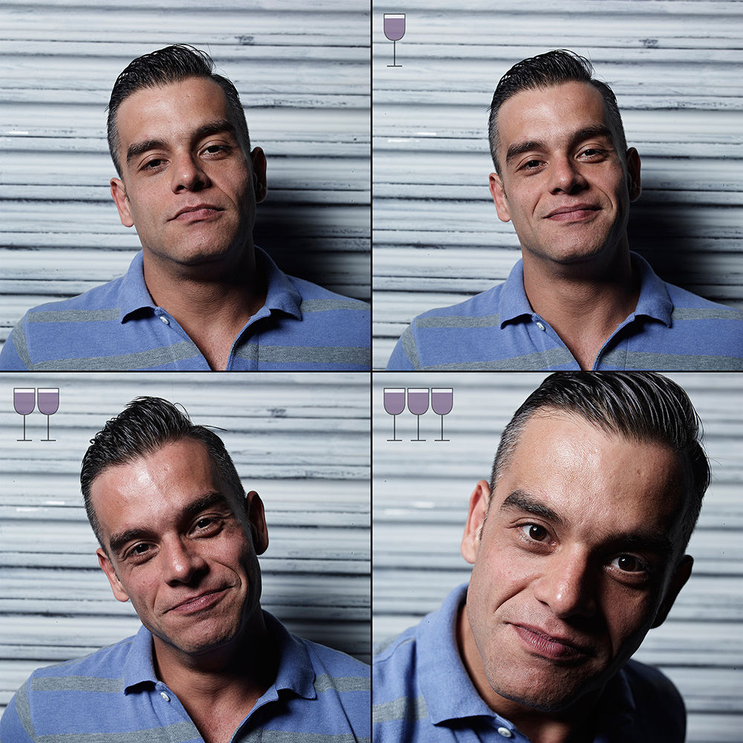
Datasets
3 GLASSES LATER
Art Project
Small sample size
Non scientific
DIF: Dataset of Perceived Intoxicated Faces
Scientific
Video Samples
Difficult Pre Processing (Hardware might be to weak)
1.
2.

Slide 5
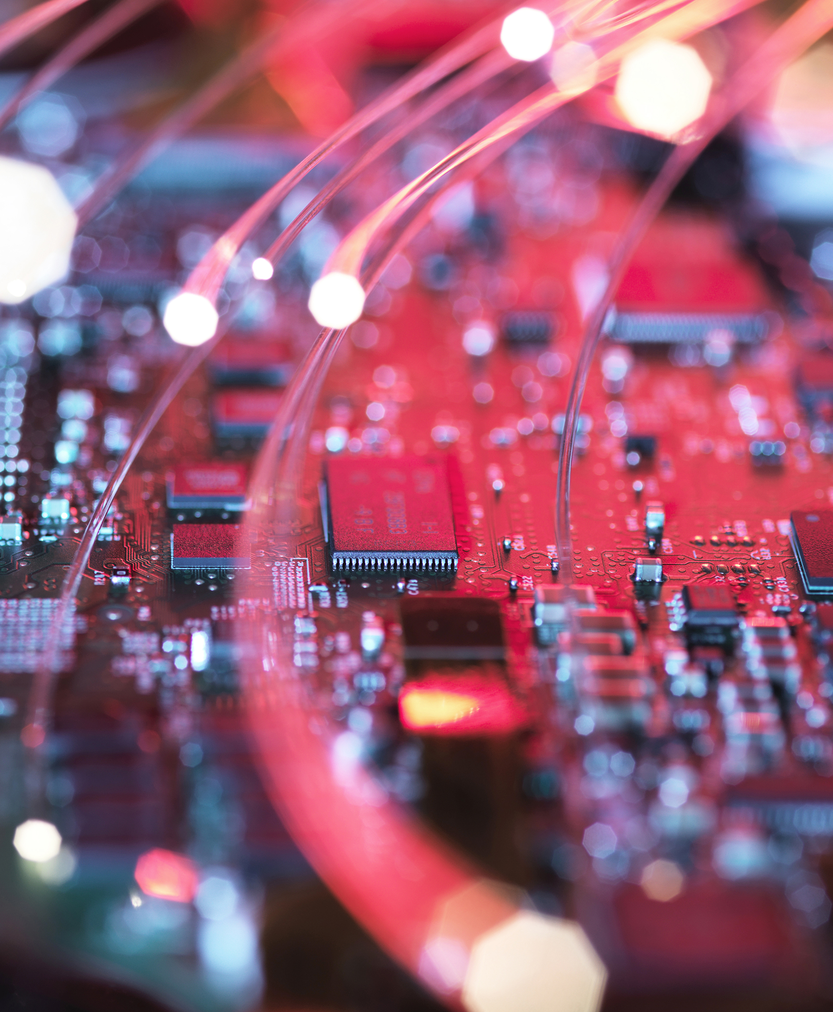
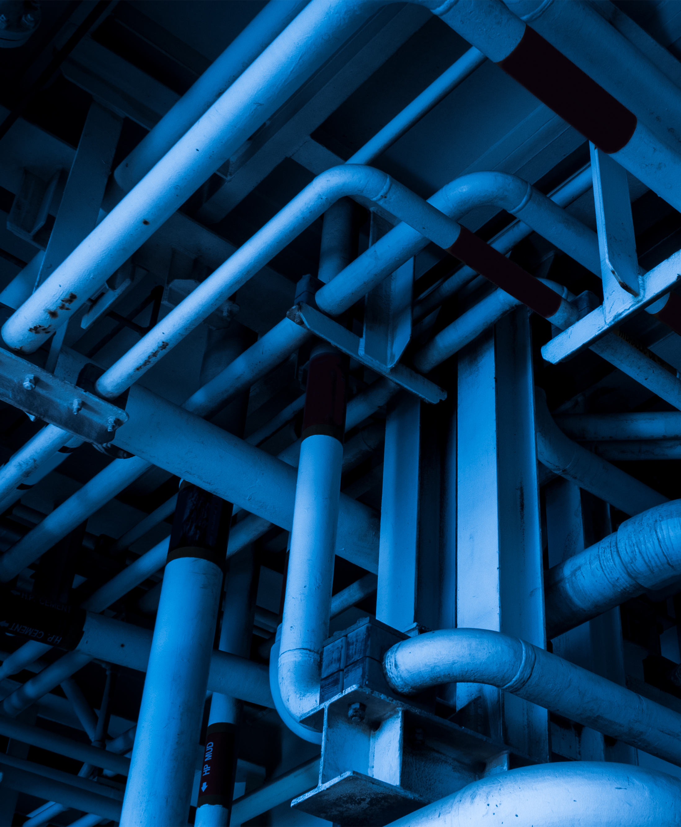
Challenges
Hardware
Pipeline
Dataset

Slide 6
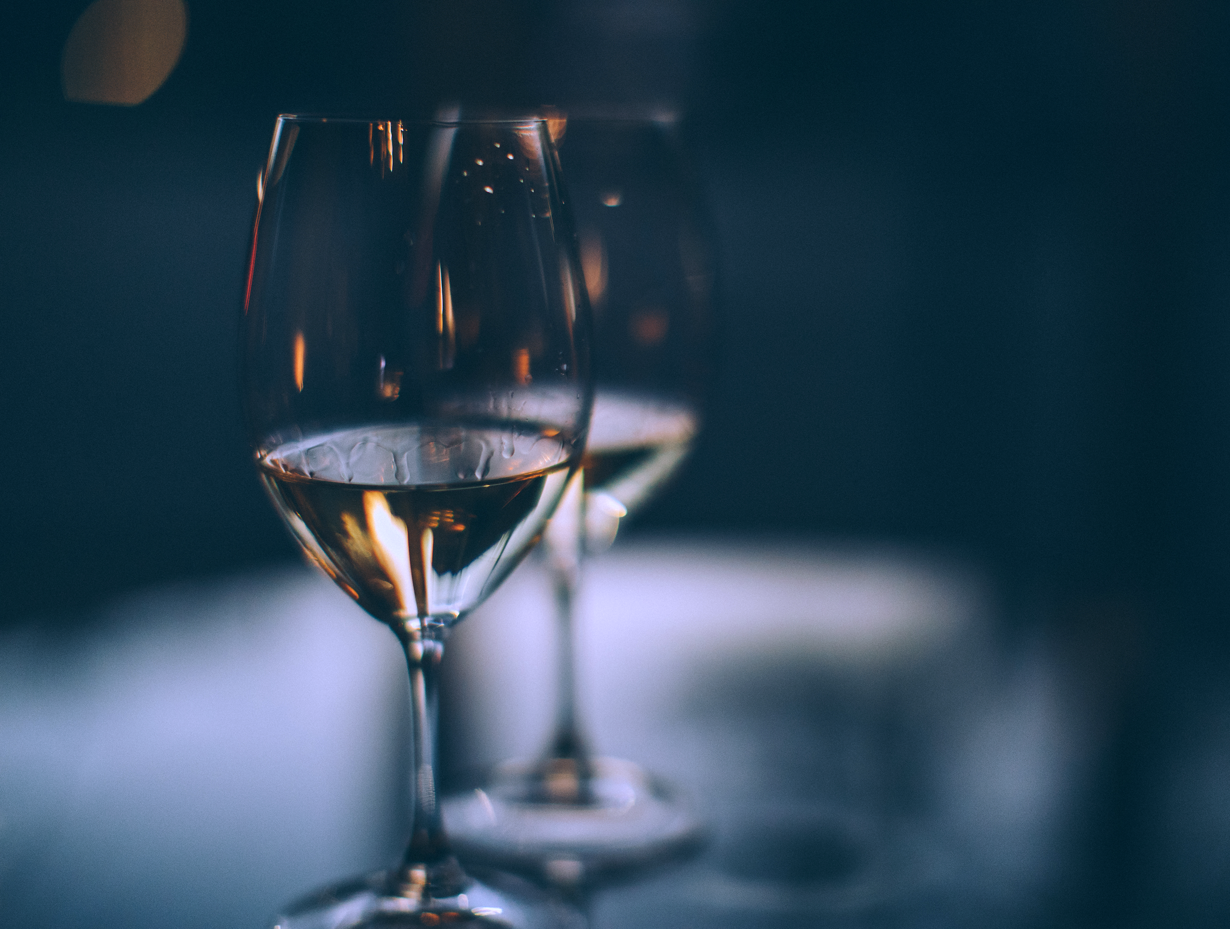
Vielen Dank
Andreas edte
Lennart fertig
Yannik hubrich
Felix hüsgen

